Slide 1

Team Building, Influencing and Leadership
Frank P. Saladis PMP
Cynthia Simeone PMP
Mark Tuscano PMP
PMI Leadership Meeting
21 October 2006
saladispmp@msn.com

Slide 2
Team Building, Influencing and Leadership
Techniques For Developing and Managing PMI Leadership Teams
Frank P. Saladis PMP

Slide 3

Session Objectives
  To identify the factors that influence you and how you influence others
  To identify key skills for developing effective project teams
  To describe techniques that will improve your effectiveness when influencing people and attempting to obtain commitment
  To describe techniques that will improve communication skills for more effective teamwork
Notes:
This webinar covers x topics.

Slide 4
Acknowledgement
Principle #1: The world is full of people who deserve to be acknowledged!
Acknowledge someone near you.
Acknowledge someone you are jealous of.
The power of Acknowledgement – Judy Umlas, IIL Publishing New York

Slide 5
Newton’s First Law
A body in motion stays in motion
Frank’s corollary to Newton’s first law
  A Leader in motion stays in motion
  A component in motion stays in motion

Slide 6
What Are You Thinking?
We are all influenced by people, places, events and situations at all times. Sometimes we are affected more or less by these things, but we are continually being influenced by what happens around us.

Slide 7
Reality Check
Answer this question:
In the work environment
What motivates you?

Slide 8
What Motivates You?
Studies show:
Challenging Job
Achievement of goals and objectives
Increasing responsibility
Growth and advancement
Enjoyment of the work
Earned Recognition

Slide 9
Top 6 Requirements of The Work Environment
Appreciation for work well done
Possibility for promotion
Feeling “In” about things
Job security
Help with personal problems
Good wages (compensation)
Interesting work
Loyalty of management toward workers
Tactful discipline
Good working environment

Slide 10
Top 3 In Rank Order
Interesting work
Appreciation for work well done
Feeling “In” about things

Slide 11
Getting Things Done
If you force someone to do something you want, without taking their point of view into consideration, then the impression that person is left with is how they will see you forever. You're stuck with it, unless you deliberately change what you do in order to be seen differently.

Slide 12
Getting Things Done
Pushing, bullying, bludgeoning or haranguing DO NOT WORK! Like elephants, people will remember the experience.

Slide 13
Influencing
Influencing is about understanding yourself and the effect or impact you have on others. Though it can, on occasion, be one way, the primary relationship is two way, and it is about changing how others perceive you.

Slide 14
Working With People
It’s a fact of life: No matter how intelligent you are, no matter how technically savvy — nearly everything you accomplish in life requires the support and cooperation of others.
Question: What are the crucial skills you need to build positive working relationships with everyone?

Slide 15
Influential People in Your Life
Self Reflection:
  Reflecting on your business and personal life, who has had the most profound influence on you?
  Make a list of these people
  How has this person (or persons) influenced you? (Think about their characteristics and behaviors)

Slide 16
Influential People in Your Life - Characteristics
  Vision
  Knowledge Champion
  Holistic Perspective
  Use of systematic processes and frameworks (The power of visualization)
  Effective communicator
  Effective interaction
  Openness
  Innovator
  Encourage personal self development
  Strong Beliefs
  Optimism
  Courage
  Teamwork
  Prepared
  Confident
  Passion
  Has Values
  Creativity
  Humility
  Planning / organizing
  Business Savvy

Slide 17
Influential Teams in Your Life
Team Reflection:
  Think about high performing teams in your life that you have been a part of, have inspired you, or have influenced your behavior:
  What makes the team “high performing?”
  How has this team (or the team leader) influenced you? (Think about how the team worked together. What was the environment like? How did the team members interact?)

Slide 18
Characteristics of High Performing Teams
  Common purpose
  Relationship of trust and respect
  Balance between task and process
  Plans before acting
  Involve all members in problem-solving
  Effective interaction
  Team members involved in decision making
  Respect for diversity
  Understanding of interdependence
  Support of team goals
  Reward individual performance that supports the team (MVP)
  Dialog instead of debate
  Balance between work and home life
  Honest and regular critique
  Focus on continuous improvement
  Adapted from Reid Moomaugh and Associates

Slide 19
Influence Defined
The ability to persuade, convince, or impact others in a way that will cause or motivate people to support your vision, goals, objectives or personal agenda.
Influencing people takes conscious thought. We need to think about what we are seeking to accomplish, our audience, and how we will plan to influence.

Slide 20
Assumptions of Influence
Assumptions of influence are based on the desire to have a specific impact or effect on others where you have a set of goals, a mission or vision to accomplish. This includes the specific type of impression you wish to make or a course of action you want others to accept and commit to.
When forming a team or becoming a part of a team, why are first impressions so important?

Slide 21
Your Agenda, Vision, Goal, Objective
What are you planning to accomplish? What is your specific need? Why is this important? Why do you need other people or a team?
In order to influence a person or group of people to buy-in to your agenda, two key players are observed: You – the message source, and your audience (the client or potential team member)

Slide 22
Your Agenda, Vision, Goal, Objective
Ask yourself:
  What actions can you personally take that will assist you in determining the most effective approach to influence people to commit to your objectives or join your team?

Slide 23
Your Agenda, Vision, Goal, Objective
Successful influence is based on:
  Credibility
  Communication
  Empathy

Slide 24
Credibility
  It is important to remember that the formula for success in influencing and team building reflects not what you think about your expertise or the trust you believe you inspire in others, but the way the other person perceives your level of expertise and whether or not they should trust you. You have to constantly monitor, prove, maintain and enhance these perceptions if you want to be able to influence others. Personal credibility and integrity are our most powerful leverage factors in influencing others or situations.

Slide 25
Credibility
Trust – developing trust between yourself and others
Consideration – Understanding what others believe to be important. Understanding personal values and priorities.
What actions can you take to improve your ability to understand the “other person’s “ point of view?
Consistency – Minimizing changes in your style. Maintaining a degree of firmness. Your reliability.
  Do you change your style depending on whom you are speaking with? Do you change your mind frequently? Are you easily influenced by others?
Expertise and Competence – demonstration of your skills and knowledge
Make a list of your strongest skills and knowledge areas.

Slide 26
Communication
Clarity – How well do you communicate? How do you know that your message was received the way you intended it to be received?
Leadership Responsibility:
  Identify, understand, and remove barriers to effective communication
List the typical barriers to communication that you experience while working on a project or with a team.
  What actions can be taken to remove these barriers?

Slide 27

Communication
How effectively do you transmit
your message to the receiver?
Message received and RNA:
  R - Rejection of the message,
  N - Neutral (no commitment)
  A – Acceptance
Hitting the target
When you are communicating information, what percentage of your message do you think hits the target?
What does it mean when you do not hit the target?
How can you improve
your message accuracy?

Slide 28
Communication
An effectively delivered message is critical in the process of influencing people to accept your mission and objectives.
Three major elements of an effectively prepared message:
  Content – What information are you planning to share?
  Context – How is the information prepared?
  Desired Impact – What is the desired response?
The “Three B’s” of Communication

Slide 29
Transmitting and Receiving Messages
Transmit / Send
Receiving
Method of Delivery | Body Language | Voice Tone | Words
In-person | 55% | 38% | 7%
Phone | 0% | 84% | 16%
Email | 0% | 0% | 100%

Slide 30
Empathy
Empathy demonstrates your ability to understand others. Empathy is often the one thing missed by emerging leaders. Expressing empathy demonstrates that unspoken or partly expressed thoughts, feelings, and concerns for others are understood.
Tips for expressing empathy:
  Listen actively
  Understand the unspoken – expressions and body language, thoughts and feelings, concerns and fears. Trust will bring out the unspoken.
  Address feelings before facts – become aware of emotional issues before introducing facts and data.
  Be sincere – your team members will assess your sincerity.

Slide 31
Organizational Awareness
  Identifying who the real decision makers are or those individuals who can influence goals or directions is one of the keys to success when seeking support for your agenda or goals. Developing scenarios about how your ideas, goals or objectives may affect lines of business is a tool that can be used to determine how successful your message will be received.
  Name the lines of business, departments, or other business components that you may affect or that affect your areas of responsibility.
  How do you interface impact, or affect these components?

Slide 32
Engaging Team Members
Identify Common Ground Similar /complimentary priorities Mutual benefits | Ask For Input Feedback on the mission / objectives What can be changed? What are the concerns? How will the person or persons be affected?
Demonstrate your commitment Why is this important to you? Why is this important to you organization? Be prepared to answer the WWIFY and WIIFM Actions | Listen Actively Display genuine interest Acknowledge the input but be careful about what you agree to Formulate a plan for responding to ideas and suggestions Follow -up

Slide 33
Obtaining Buy-In and Commitment
Proposing/Recommending What is the mission / objective How can this mission / objective be accomplished | Providing justification Why is this mission/objective necessary? Improving service Customer satisfaction Employee benefits ROI
Stating expectations What is needed? By whom? When? Restrictions on how? | Opportunities/Consequences What can happen if successful? What can happen if not undertaken? What are the potential rewards? What are the potential penalties?

Slide 34
Nine Rules to Improve Any Relationship
  Nine Rules to Improve any Relationship
  1. Show genuine enthusiasm when you greet a person or a team.
  2. Show respect to each individual or team member.
  3. Be supportive
  4. Give the individual or the team the benefit of the doubt.
  5. Give the individual or the team a chance to contribute as much as possible.
  6. Let the individual or team know you appreciate them.
  7. Wait 24 hours if the person angers you before you respond.
  8. Talk up-front about what’s bothering you
  9. Share yourself and trust the individual or team. (depends on the type of relationship – individual, comfort level, culture etc.)

Slide 35
A Few Words About Leadership
A five year old defines leadership:
“Leadership is like follow the leader. You follow someone until they do something really stupid and then you follow someone else!”

Slide 36
Leadership and Management
M - My
A - Actions
N - Never
A - Actually
G - Generate
E - Enthusiastic
R - Response
L - Likeable
E - Energetic
A - Attitude
D - Deserving
E – Everyone’s
R – Respect

Slide 37
Leadership and Teams
T - They
E - Eventually
A - Accept
M - Me
T - Terrific
E - Experience
A - Among
M - Members

Slide 38
Leadership and Project Management
  Establishing direction – Developing a vision of the future and the strategies to achieve that vision.
  Aligning people – Communicating by words and deeds.
  Motivating and inspiring – Energizing and helping people to overcome barriers to change.
PMBOK® Guide 2004

Slide 39
Leadership and Project Management
It is followers, not organizations, that convey leadership. And before people will allow you to lead them, you must understand what they want from you and what they expect of you.
James P. Lewis

Slide 40
Leadership and Project Management
The clear and distinguishing feature about the process of leadership is the distinction between mobilizing others to do and mobilizing others to WANT to do.
The difference between enlisting support and giving orders
Between gaining commitment and commanding obedience

Slide 41
Leadership and Project Management
The Law of Connection
You can’t move people to action unless you first move them with emotion
Connecting with people needs to happen at the individual level, not just in groups
The stronger the relationship and connection between individuals, the more likely the follower will want to help the leader.
Law #10 of the 21 Irrefutable Laws of Leadership – John C. Maxwell

Slide 42
Connecting the Energy
Kinetic- from the Greek word kinetikos: of or relating to the motion of material bodies and the forces and energy associated therewith.
Energy- from the Greek word energeia: The capacity of acting or being active, natural power vigorously exerted
Kinetic Energy- Energy associated with motion

Slide 43
CONNECT-tic Energy
The sustained energy experienced through a continuous movement forward, refueled by communication, lessons learned, teamwork, sharing of experiences, and visionary leadership.

Slide 44
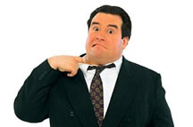
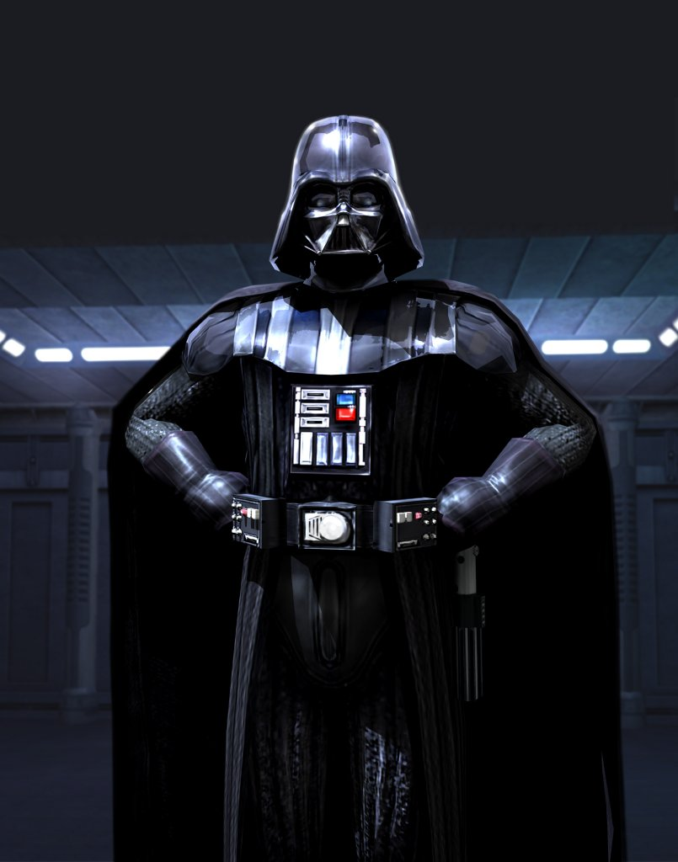
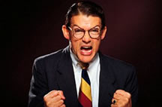
The Dark Side of Leadership
  Force
  Punishment
  Fear
  My way or the highway
  When I want your opinion I’ll give it to you

Slide 45
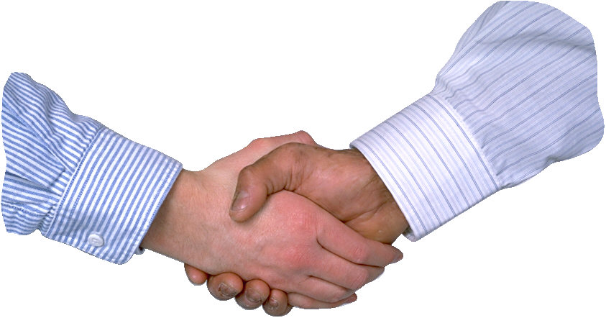
Positive Leadership
The focus is on:
  The needs of the organization
  The people performing the tasks
  The right decisions
  Understanding the impact of a decision
  Mitigation of the results of unpopular decisions
Not on:
  Personal interests
  Ego
  Effect of politics

Slide 46
Personal Influence Action Plan
  I can consistently influence people in my organization by:
    (What specifically can you do?)
  I can accomplish this by:
    (Actions you will take to accomplish your goal)
  I will do this by (Date)
  I can improve my ability to influence by:
    (What specifically can you do?)
  I can accomplish this by:
    (Actions you will take to accomplish your goal)
  I will do this by (Date)

Slide 47
The International Project Environment
Information Management
Creativity
Customs
Clients
Culture
Project
Management
Constraints
Geography
Religion
Language
Methodology
Integration
Integration

Slide 48
International Project Management Day November 2, 2006
Individually | Organizationally | Locally | Internationally
Thank your project manager or teams by phone, email, card, or in person | Recognize the PMO for their contributions to the organization | Attend a project management association meeting | Attend a special Webinar hosted by The International Institute for Learning
Take a project manager to lunch | Communicate and celebrate project successes | Schedule a recognition event for project managers | Join a project management association
Ask how a project is going and show interest in results | Sponsor a project management “coffee break” | Publish an article in a local newspaper or newsletter | Observe and learn about international projects that impact your community or quality of life

Slide 49

Questions?

